Slide 1



Credit Card Model
Esecutive summary
Access complete documentation, click here:
https://github.com/Luanathamiris/case_neon
November, 2023
Luana de Oliveira

Slide 2



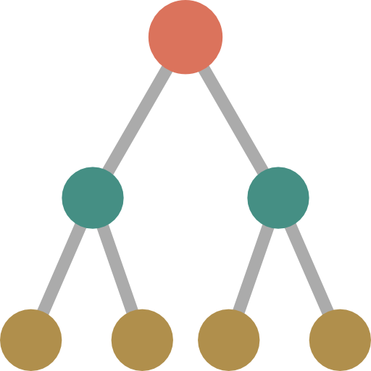



Data Modeling
1
2
3
4
Base preparation
Data processing
+ Analysis of quality information
Experiments
Finding the best combination of technical parameters that results in the best model
Importance analysis of variables
5
6
7
Model DiscriminationKS, AUC, etc.
Analysis by decile: ordering, stability
Score distribution
Usage Assessment by the Policy team
Documentation + Process Automation

Slide 3
Data Modeling
1
2
Base preparation
Data processing
+ Analysis of quality information
Variables with >=70% missing were removed (-3)
For variables with <70%, imputing the mean was used as a criterion;
Correlation analysis (60% and 70%) (-24, -8);
Outlier detection;
Dummies variables;
Normalization of some variables.
104 variáveis

Slide 4
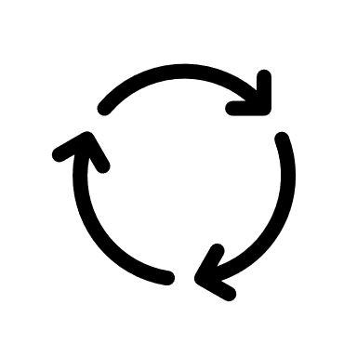
Data Modeling
1
2
3
Base preparation
Data processing
+ Analysis of quality information
Experiments
Finding the best combination of technical parameters that results in the best model
Variable selection – Forward (premise – top 30);
Three techiniques were tested: Logistic Regression,
Random Forest and,
Super Vector Machine;
For all these techniques, hyperparameter adjustment was performed;
For each technique, the respective parameters were adjusted.

Slide 5
Data Modeling
1
2
3
4
Base preparation
Data processing
+ Analysis of quality information
Experiments
Finding the best combination of technical parameters that results in the best model
Importance analysis of variables
Graph with the importance of variables;
Check if any variable has an importance equal to zero;
SHAP chart.

Slide 6

Data Modeling
1
2
3
4
Base preparation
Data processing
+ Analysis of quality information
Experiments
Finding the best combination of technical parameters that results in the best model
Importance analysis of variables
5
AUC;
Precision;
Recall;
F1-score;
KS;
Ordering in deciles;
PSI;
“Safras” analysis.
Model DiscriminationKS, AUC, etc.
Analysis by decile: ordering, stability
Score distribution

Slide 7
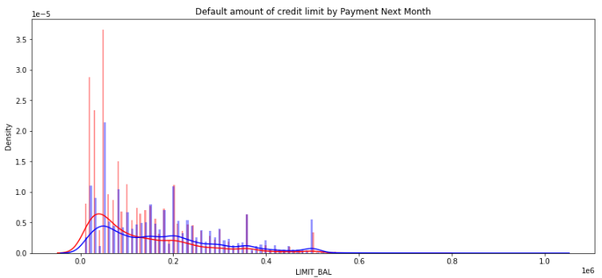

Results
Amount of credit limit
Amount of credit limit
There is a concentration of cases with a limit of 50k, followed by a limit of 20k;
The majority of defaults are for credit limits of up to 100,000, as well as there is a higher concentration of defaults;
The highest default numbers are for amounts of 50k and 20k;

Slide 8
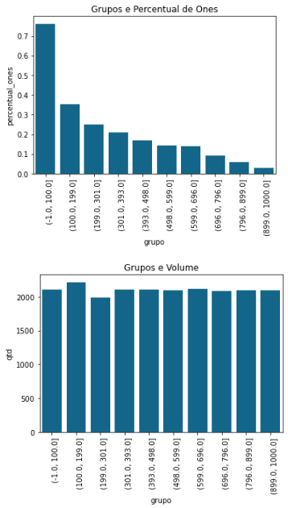
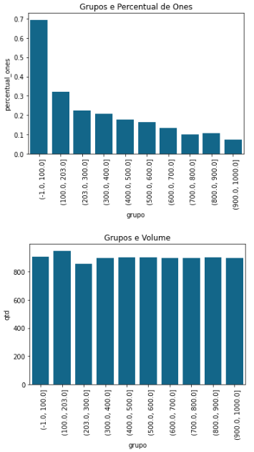
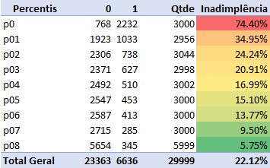
Results
Models
Ordering of quartiles
Train
Test
Public | Model | Accuracy | Precision | Recall | F1-Score | KS
Train | RF | 0.833 | 0.782 | 0.342 | 0.476 | 0.413
Train | SVM | 0.822 | 0.709 | 0.334 | 0.454 | 0.331
Train | Logistic | 0.781 | 0.505 | 0.434 | 0.466 | 0.316
Test | RF | 0.817 | 0.694 | 0.311 | 0.43 | 0.345
Test | SVM | 0.817 | 0.689 | 0.319 | 0.436 | 0.291
Test | Logistic | 0.779 | 0.500 | 0.430 | 0.462 | 0.323
Inadimplência nos percentis

Slide 9
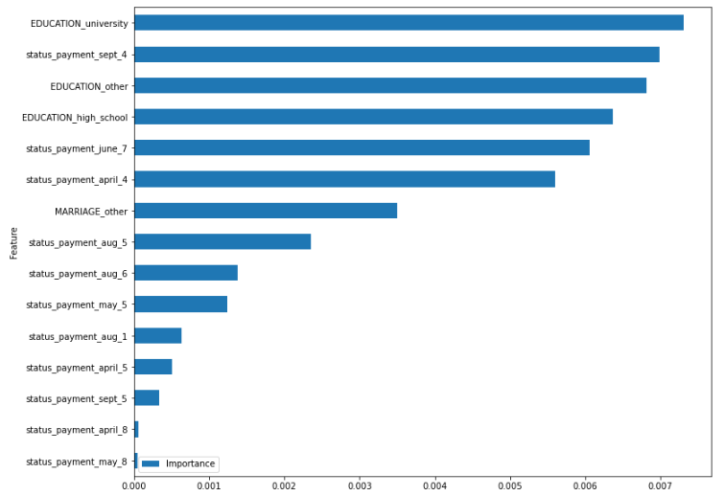
Results – Importance of variables - top 15
Variáveis explicativas
25 variáveis

Slide 10
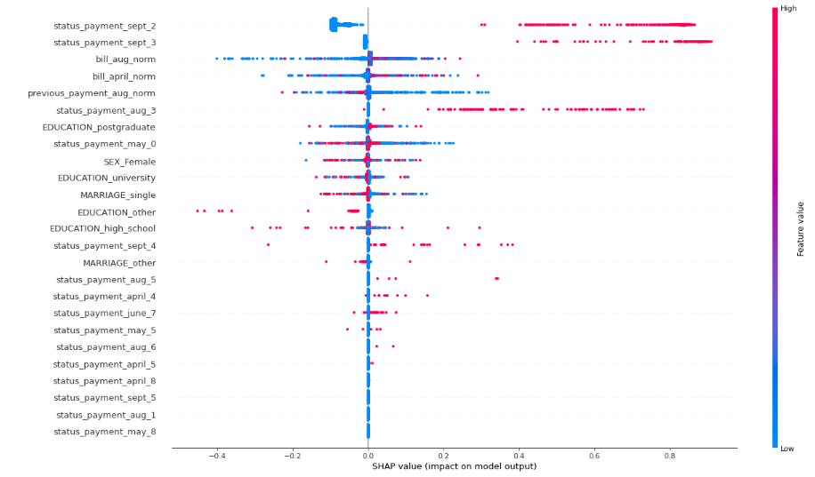
Results – Shap

Slide 11
Refinements and limitations
As this is a case with a naturally shorter development time, some premises were established in order to illustrate a possible solution, even if this, for the model in question, is not the one that will generate better performance;
It is understood that there are more robust techniques, both in the selection process and in the development of the model, but due to a trade-off we chose to follow the path presented;
Tests with a range of harvests different from those presented could be tested to improve the model, as well as separate a sample from the data set for validation, in addition to the harvests destined for the OOT;
As the modeling process is circular, all steps could be redone with adjustments based on the previous result to improve the next performance;
There is sufficient evidence to conclude that the model needs refinement to a production-ready version;
It is noteworthy that the main objective of this presentation was to portray the entire process of developing a model and how the results can be presented and analyzed.
Thanks!

